Slide 1
Cloud Security
IT22560094
Mojitha Ranasinghe

Slide 2
CONTENT
What is cloud computing
What is cloud security
Key threats and solutions
Evolution of cloud security
Future development in cloud security

Slide 3
1.What is cloud computing?
Cloud computing is the mechanism to store data online.
It offers remote digital services.
Cloud users can gain access via the internet.
This mechanism enhances flexibility and global accessibility.
Everyone has experience using these cloud computers.

Slide 4


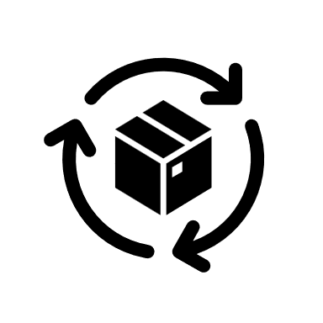

2. What is cloud security
Data and recourse security
Safeguard against cyber threats and breaches
Method of providing
Authentication and encryption
Detecting and fixing vulnerabilities

Slide 5







3. Key threats and solutions
1. Data security and confidentiality
2. User Authentication
2. Multifactor Authentication (MFA).
Solutions
Threats
3. Cloud storage
security.
3. Identify the access management (IAM)
4. Virtualization
Vulnerabilities
4. Vulnerability scanning and penetration testing

Slide 6
4. Evolution in cloud security
Early 2000s
Cloud computing gain attention and businesses start to use it.
Large companies start to offer cloud services with security.
Cloud computing grow significantly.
This growth attract more sophisticated cyber-attacks.
So, cloud providers starts to built security with global countermeasures.
2010 cloud security get global momentum
Because of the pandemic situation businesses start to use cloud environment more than ever.
New threats and vulnerabilities shows up.
To prevent those things new technologies and methods were built in.
Cloud IAM identity, single-sign-on, penetration test…
Present 2020s cloud developments

Slide 7
6. Future developments in cloud security
DevSecOps consider security from the start.
It make sure security is everyone's job not only the security teams.
This way cloud computing is safer from the potential threats.
Extended Detection and Response (XDR)
Helps to secure remote accesses in the cloud environments.
ZTNA use the idea of “ Trust should be earned for each users”.
To earn that trust it use several tools
Development Security and Operations integration
(DevSecOps)
Zero Trust Network Access
(ZTNA)
Eliminate the need of multiple security tools.
XDR serves as all-in-one security platform.
XDR can detect threats and response those threats.

Slide 8
THANK YOU
Mojitha Ranasinghe
IT22560094
YEAR 2 SEMESTER 1
CYBER SECURITY
ICS MODULE

